Slide 1
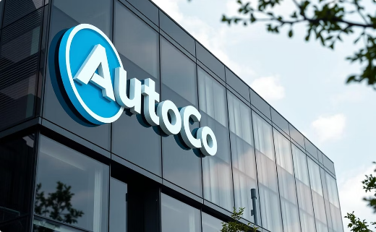


Market Entry Strategy: Classical vs Collaborative Robotics
About AutoCo
Strategic Focus
Team Mission
Industry leader with 26,000+ employees and $6B+ sales in 2020. Founded in 1854 in Glasgow.
CEO Julia Meiners drives innovation and modernization.
Assess market entry potential for both robotics types.
Investments target Classical and Collaborative Robotics.
Using Porter's Five Forces and BCG Matrix for analysis.
Currently experiencing a slight sales decline.
GROUP 3
Hardik Goel - 468526 | Nisha Kulhari - 471109
Mayuri Mhetre - 468178 | Vijayan Shinde - 465577
Abishai Srinivasan - 471538 | Prakhar Srivastava - 470031
Image Source: AI-generated (OpenAI)

Slide 2

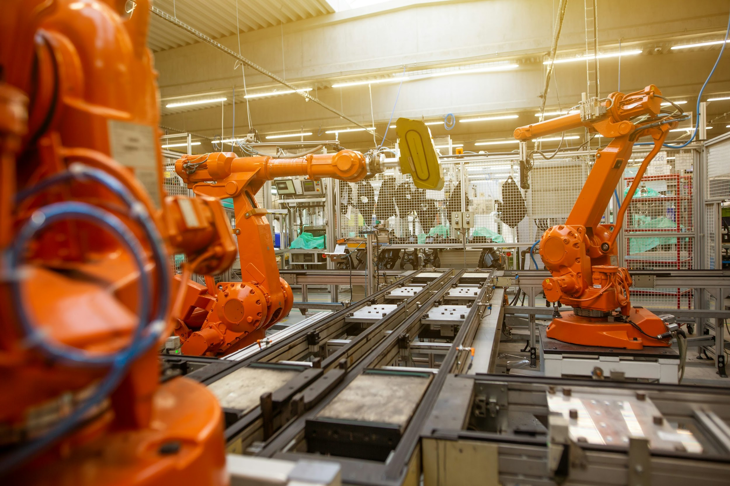
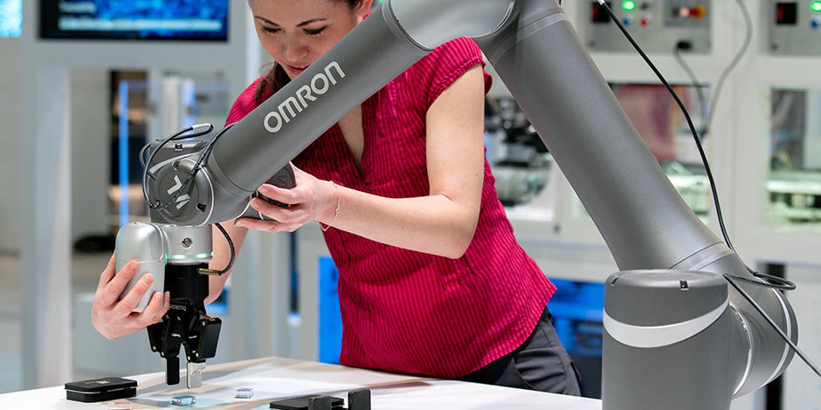
Collaborative Robots vs Traditional Robots a Basic Introduction
Aspect | Traditional Robots | Collaborative Robots (Cobots)
Workplace Setup | Requires isolated environments with safety barriers; costly and rigid infrastructure. | Safe to work alongside humans; minimal setup, ideal for dynamic factory floors.
Flexibility | Best for repetitive, high-volume tasks; slow and expensive to reconfigure. | Highly flexible and easy to reprogram; ideal for low-volume or frequently changing tasks.
Human Integration | Limited or no direct interaction; separate workflow from human workers. | Designed for direct collaboration; enhances human productivity and reduces downtime.
Current Market Size | ~$30–40 billion (as of 2024), dominant in automotive & electronics. | ~$3–5 billion (as of 2024), rapidly gaining adoption in SMEs and new sectors.
Growth Rate (CAGR) | 10–12% annually through 2030. | ~40–45% annually through 2030.

Slide 3

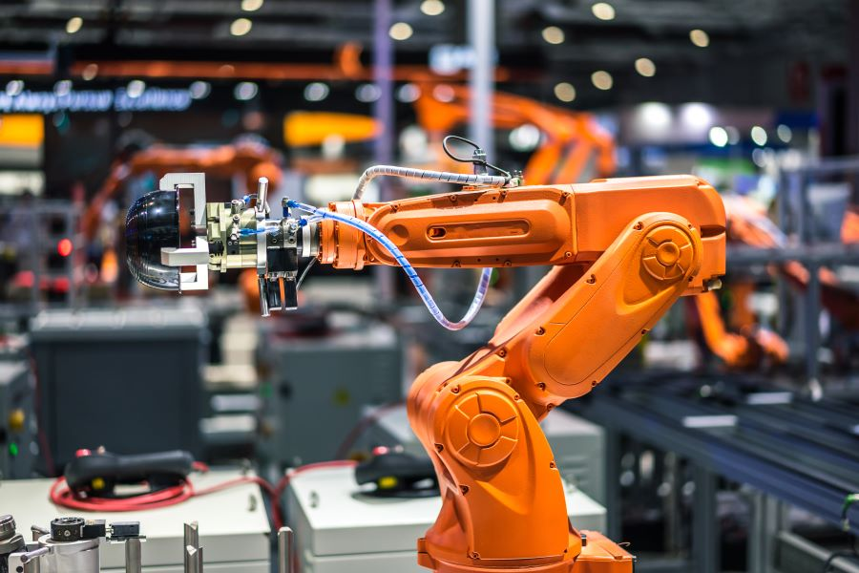
Porter’s 5 Forces Analysis
Strength
Low Medium High
Bargaining power of suppliers
Threat of substitutes
Classical Robots
Key components are specialized and not easily substitutable.
Limited sources for sensors & chip supply
Cobots
Concentration in precision components (gears, sensors)
Forward Integration Threats – NVIDIA, Siemens
Supply chain disruptions - Chip shortages
Classical Robots
Substitution threats from cobots, manual labor & low cost automation
Cobots
Threat of new entrants
Industrial robots and manual labor are alternatives
Labor shortages boost demand for automation
Cost and flexibility advantages over traditional robots
Growing buyer preference for cobots
Classical Robots
Significant R&D investment and capital required
Technical Expertise needed - AI, Robotics, software
Cobots
High initial investment required - Not more than classical robots though
Faster ROI than traditional robots for SMEs
Strict safety standards for product commercialization
Technical complexity due to reconfigurable system requirements for cobots
Industry rivalry
Classical Robots
Global competition: ABB, FANUC, KUKA, Siasun
Price competition: Especially from China - Example: Siasun, increase rivalry
Rapid innovation: AI, Cobots
Bargaining power of buyers
Cobots
Market valued at $4.27B in 2024
Dominated by 7 major players; 68% share: ABB, FANUC,Universal, etc.
Startups hold 32% share, increasing competition
High innovation and growing SME adoption fuel rivalry
Classical Robots
Large industrial clients
Moderate to High switching costs
Demand for Custom solutions
Cobots
Revisiting regulatory compliances add to switching costs
Diverse client industries reduce buyer concentration
Many small buyers limit individual bargaining power

Slide 4




Market Share
Cobots: Assembly Line (eg: Electronics assembly), Packaging (eg: Mobile Arms, Pick and Place), Machine Tending (eg: Load/ Unload)
Rapid adoption in SMEs (small and medium ent.), flexible automation and safety.
Traits: High market growth + High market share
Why: Surging demand from SMEs for safe, user-friendly automation.
Action: Invest heavily in R&D and scale production to maintain leadership.
AI Cobots: Autonomous Mobile Cobots, AI Quality Inspectors, etc.
Emerging, high-growth field with AI and vision integration.
Traits- High growth + Low share (unproven ROI - e.g., surgical cobots).
Why : Potential disruptors but need validation.
QUESTION MARK
STAR
Action : Test pilots; Limited trials; partner with tech firms before scaling.
Market Growth
BCG
Matrix
Classical Robots - Automotive Welding, Palletizing (eg: fixed arms stacking boxes), Paint bots
Dominant in automotive/mass production
Traits: Low market growth + High market share
Why: Mature markets (automotive/electronics), profitable, but stagnant (replaced by cobots in many areas).
Action: Optimize costs; use profits to fund Stars (cobots).
Legacy Single-Task Robots:
Fixed -Pick & Place (eg: bottling lines from 1990s), Dedicated Stamping, Obsolete SCARA (PCB Assembly)
CASH
COW
DOG
Outdated by modular cobots.
Traits: Low growth + Low share (outdated by modular cobots).
Why: Costly to maintain; limited demand, Outperformed by flexible cobots.
Action: Phase out or retrofit for niche uses (e.g., harsh environments, backups).

Slide 5
Conclusion
Collaborative robotics - a promising field in the robotics:
A diverse customer base, consisting of mostly SMEs, provides more potential to sell
A lower initial investment reduces the risk and decreases the ROI timeperiod
Future of technology - aligns better with the aspirations of the young CEO
Safe for human collaboration; no need for isolated environments or rigid infrastructure.
Ideal for dynamic, low-volume tasks with quick reprogramming capabilities.
Cobot market growing at 40–45% CAGR — a future-ready investment.
Cobots portray High Growth + High Market Share
Easier entry point in Cobots, acquiring or collaborating with startups to get initial research.
Next steps:
Invest into R&D of cobots
Plan the product commercialisation keeping the regulatory compliance in mind
Start forming business alliances with the suppliers to counter component shortages and competition

Slide 6
References
https://www.marketsandmarkets.com/ResearchInsight/collaborative-robot-market.asp
https://cdn.sick.com/media/docs/6/96/996/whitepaper_safe_robotics_en_im0072996.pdf
https://www.iff.fraunhofer.de/en/business-units/robotic-systems/covr.html
https://www.grandviewresearch.com/press-release/global-precision-gearbox-market
https://cdn.sick.com/media/docs/6/96/996/whitepaper_safe_robotics_en_im0072996.pdf
https://www.therobotreport.com/collaborative-robotics-market-grow-20-30-annually/
https://www.qualitymag.com/articles/98192-collaborative-robots-emerge-as-viable-automation-options-for-smes
https://www.therobotreport.com/collaborative-robotics-market-grow-20-30-annually/
https://standardbots.com/blog/cobot-vs-industrial-robot
https://www.qualitymag.com/articles/98192-collaborative-robots-emerge-as-viable-automation-options-for-smes
https://www.verifiedmarketresearch.com/product/collaborative-robot-cobot-market/
https://www.businesswire.com/news/home/20240701300646/en/Global-Collaborative-Robot-Cobot-Market-Report-2023-2033-SMEs-Drive-Economic-Boom-with-Affordable-Versatile-Cobots-Revolutionizing-Automation---ResearchAndMarkets.com
https://ifr.org/
https://www.businesswire.com/news/home/20250224516937/en/Industrial-Robotics-Global-Strategic-Industry-Research-Report-2024-2030-The-Robot-Led-Automation-Revolution-is-Here-Transforming-the-Industrial-Sector-Beyond-Recognition---ResearchAndMarkets.com
https://www.nextmsc.com/report/collaborative-robot-market
https://www.researchgate.net/publication/330231899_Collaborative_and_traditional_robotic_assembly_a_comparison_model

